Slide 1


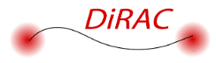
Ly𝛼 emission as a sensitive probe of EoR: the role of feedback, mergers and IGM damping
Yuxuan Yuan
Institute of astronomy, University of Cambridge
Collaborators: Martin Haehnelt, Sergio Martin-Alvarez, Debora Sijacki, Thibault Garel, Callum Witten, Laura Keating
Notes:
Hello everyone. I am Yuxuan, a final-year PhD student at IoA, Cambridge, working with Martin, Sergio, and other collaborators as listed. Today my topic is “Ly$α$ emission as a sensitive probe of the epoch of reionization: the role of feedback, mergers and IGM damping”.

Slide 2
Scientific question and content
Questions:
• When does reionization start?
• Which galaxy contributes to reionization?
• Origin of recently detected high-z LAEs?
Content:
• Ly𝛼 is a sensitive probe of the feedback-regulated LyC escape (Yuan+2024 arxiv: 2401.02572)
• Galaxy merger as an origin of high-z LAEs (Witten+2024 arxiv: 2303.16225)
• Visibility of high-z LAEs (Yuan+ in preparation)
Notes:
EoR is the phase transition between the neutral and ionised hydrogen state of the Universe. However, its exact evolution is still poorly understood and several vital questions remains. When does reionization start? Which type of galaxy contributes to reionization? What is the origin of the recently detected high-z LAEs? In this talk, I will present three projects that give some new thoughts to these questions. The first one illustrates that Ly$α$ is a sensitive probe of the feedback-regulated LyC escape. The second one explores the prospect of galaxy merger as an origin of high-z LAEs. The third one further investigates the visibility of the high-z LAEs.

Slide 3
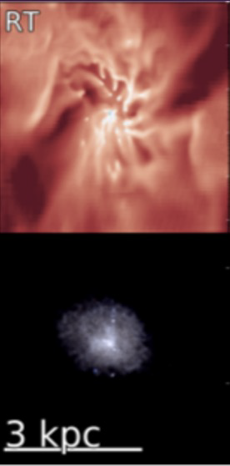
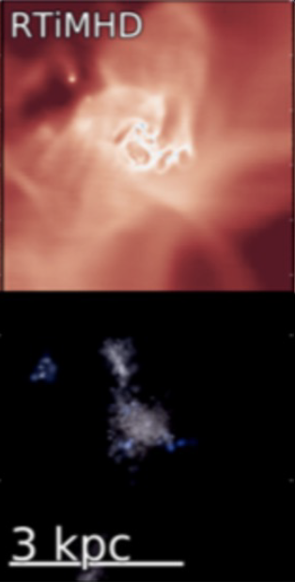
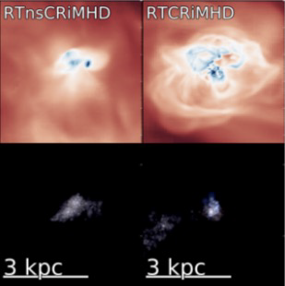

Ly$α$ modelling with different physical implementation
PANDORA: Cosmological zoom-in simulation suite of dwarf galaxies
RAMSES-RT: Supernovae (SN) feedback, radiative transfer (RT); magneto-hydrodynamics (MHD); cosmic ray (CR)
Postprocessing with RASCAS to generate the Ly$α$ observables.
Martin-Alvarez+2023
Notes:
In the first project, we resort to Pandora, a cosmological zoom-in simulation suite of dwarf galaxies. Pandora is simulated with RAMSES-RT and incorporates several physics including SN, RT, MHD, and CR. PANDORA has many combinations of these physics. Here from left to right, we have the base RT, then adding magnetic field, and CR without and with streaming. We see different physics leads to different gas kinematics and morphologies. RT effects including photoionization disperse the galaxy. B field makes the galaxies more compact. CR transports cool gas clumps from the galaxy centre into the outflow. We post-process the simulations with the Monte-Carlo radiative transfer code RASCAS to generate synthetic Lya observables.

Slide 4
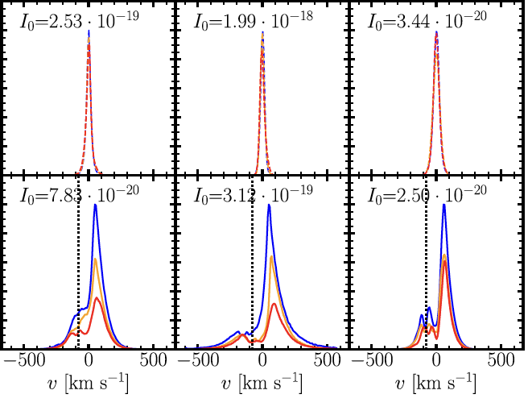

$$z∼3.5$$
RT
RTiMHD
RTCRiMHD
Ly𝛼 spectra
Prominent red peaks due to outflows
Different physics give different shapes of Ly𝛼 spectra
intr
scat
Yuan+2024
Notes:
Here we show the intrinsic and scattered Lya spectra along three different LOSs. Different columns show different simulation runs. We see the intrinsic spectra are narrow Gaussian but after resonant scattering, all of them show double-peaked profiles with prominent red peaks due to outflows. We also see different physics give different shapes of Ly𝛼 spectra. For example, they have different velocity separation, R2B ratio and fesc_lya.

Slide 5
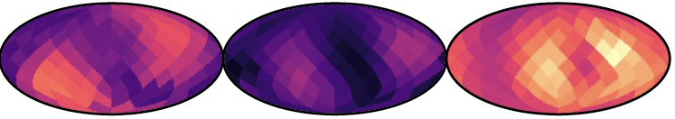
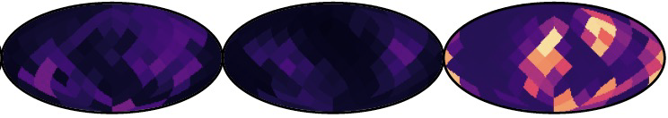


Ly𝛼 and LyC escape
RT
RTiMHD
RTCRiMHD
$$f_{esc, Lyα}$$
$$f_{esc, LyC}$$
Yuan+2024
Ly𝛼 and LyC escape through low-density channels
Different simulated physics have a huge impact on Ly𝛼 and LyC escape.
Notes:
We next show the angular distribution of Lya and LyC escape fraction for the same snapshots. We find that both Lya and LyC have a much larger escape along two low-density channels created by feedback. However, the width of LyC escape channels are lower than those of Lya, meaning that LyC is harder to escape. We also see different simulated physics have a huge impact on Ly$α$ and LyC escape, with RTCRiMHD showing the largest values.

Slide 6
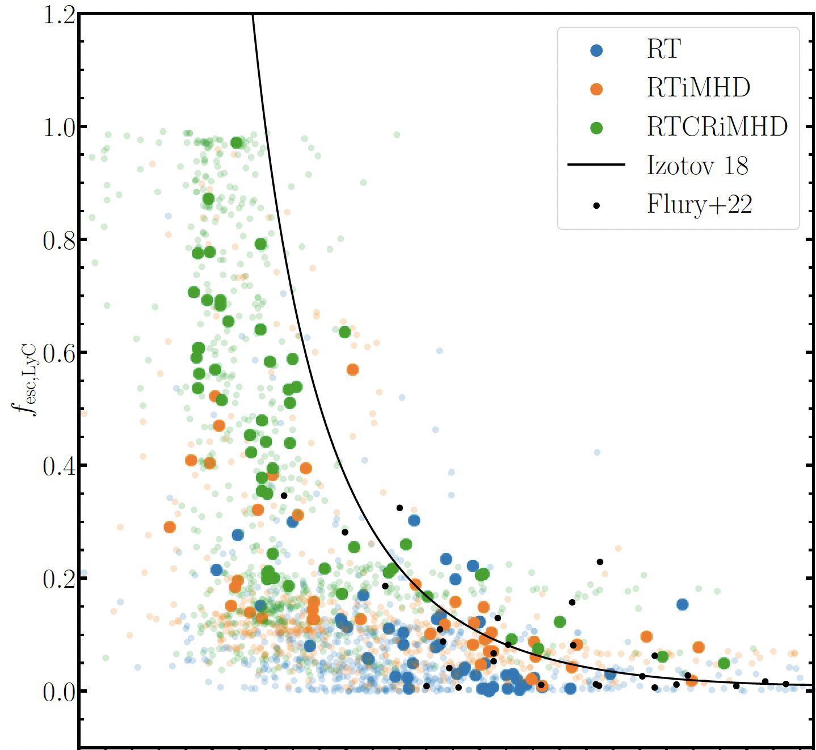


Ly𝛼 probes LyC escape
Reproduce the Izotov+2018 relation
Three simulations span a universal relation
The inner connection between Ly$α$ and LyC is robust against different physics
$$v_{sep}$$
Yuan+2024
Notes:
We perform a statistical study for all snapshots in all three simulation runs and explore the prospect of using Lya to probe LyC escape. Here we compare the LyC escape fraction to the velocity separation, with blue points for RT, orange for RTiMHD, and green for RTCRiMHD. The large solid points show the angle-averaged results while the small transparent points show the individual LOS results. Our results reproduce the observed relation found by Izotov et al 2018, shown by the black line. We see different simulations occupy different regions of this parameter space, but they all together span a universal relation. This indicates the inner connection between Lya and LyC is robust against different physics.

Slide 7
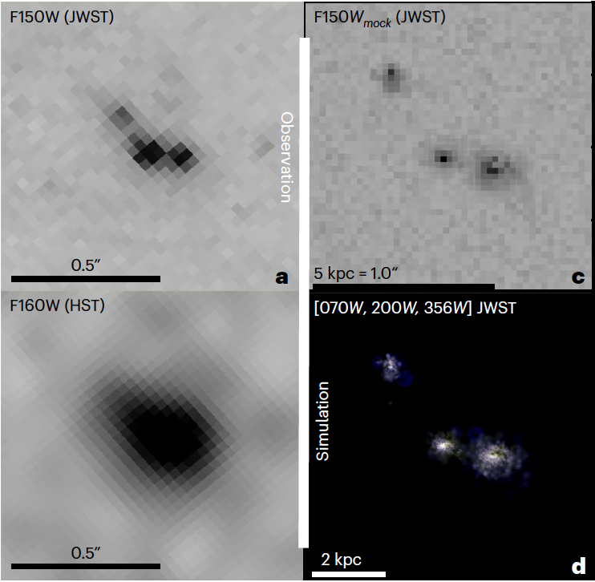
Galaxy Merger as an origin of high-z LAE
observation
simulation
All galaxies in our sample of high-z LAEs show close companions
Analogue merger in RTnsCRiMHD simulation in Azahar suite as observed object EGSY8p68
Witten+2024
Notes:
We now move on to the second project, exploring the prospect of galaxy merger as an origin of high-z LAE. We found that all galaxies in a sample of high-z LAEs have close companions. Surprisingly, we targeted an analogue merger in RTnsCRiMHD simulation in Azahar suite as observed object EGSY8p68. Here we show the JWST/HST observation on the left and the simulation on the right. We see that these two mergers have similar morphology. Further quantitative analysis confirms they also have similar stellar mass, SFR, and Lya luminosity.

Slide 8
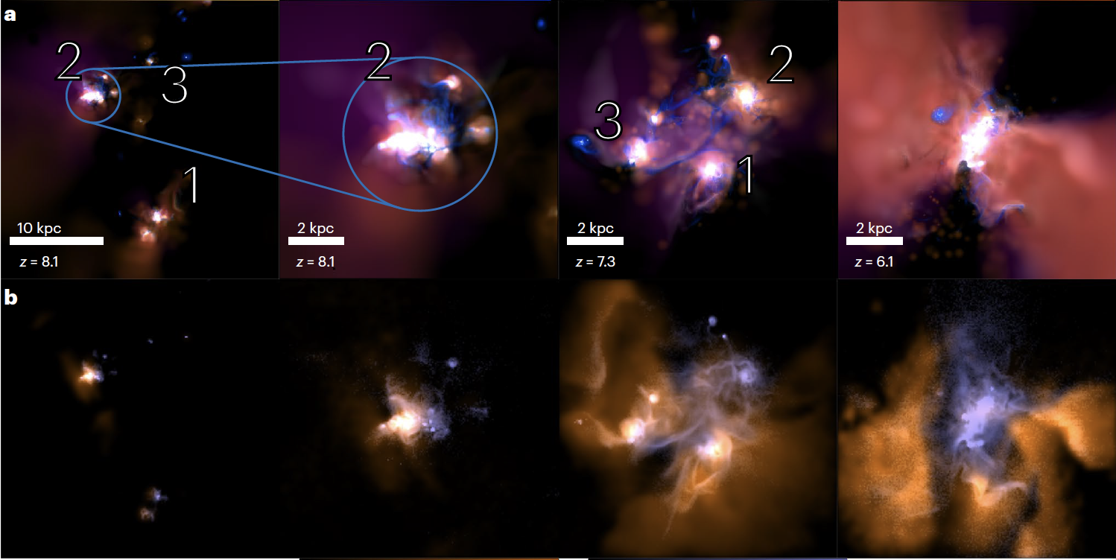





Merger sequence
$$z=8.1$$
$$z=8.1$$
$$z=7.3$$
$$z=6.1$$
Witten+2024
Isolated -> merger -> disc
Scattered Ly$α$ images lose some of the merger signature
Notes:
We investigate the whole merger sequence of this analogue merger. The top row shows the multi-color images showing gas density and radiation field. At z~8.1, we have a large-scale view of the main progenitor galaxy 2 and its approaching companions. At z=7.3, feedback drives low-density channels through the ISM, with a substantial amount of gas tidally stripped from the galaxies. Last at z=6.1, we show a post-merger view of the newly formed disk galaxy.
In the bottom row, we show the intrinsic Lya emission in blue and scattered Lya in orange. We see that scattered Lya images lose some of the merger signatures. For example, scattered Lyα emission is only present in galaxy 2 at z=8.1 and around galaxies 1 and 3 at z=7.3.

Slide 9
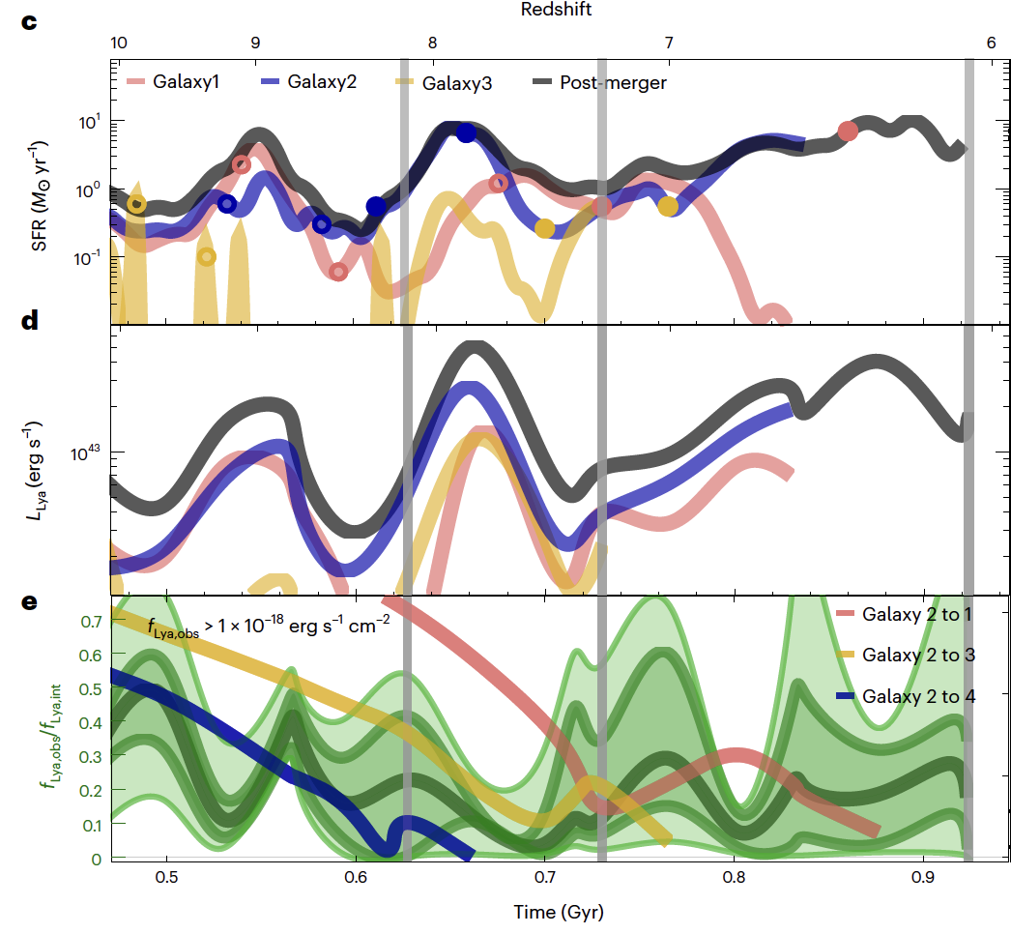
Merger triggered Ly𝛼 burst
Merger triggers high SFR that drives brighter intrinsic Ly𝛼 emission, which enhances their visibilities.
Tidal stripping and feedback clear low-density channels, helping the escape of Ly𝛼
Witten+2024
Notes:
We now proceed to more quantitative analysis. the top row shows the SFH for our three merging galaxies and the whole system. The SFR undergo repeated burst cycles, driven by numerous mergers, and a high SFR plateau during the final merger episode. This is mirrored in the evolution of the intrinsic Lyα emission as shown in the middle row. Our simulations hence demonstrate that mergers trigger high SFR that drives brighter intrinsic Lyα emission, which enhances their visibilities. In the third row, we show the ratio of the scattered to intrinsic Lya flux in green curves and its LOS uncertainties in shaded regions. We see that during mergers, shown by the jump of these lines, tidal stripping and feedback clear low-density channels, helping the escape of Lyα.

Slide 10
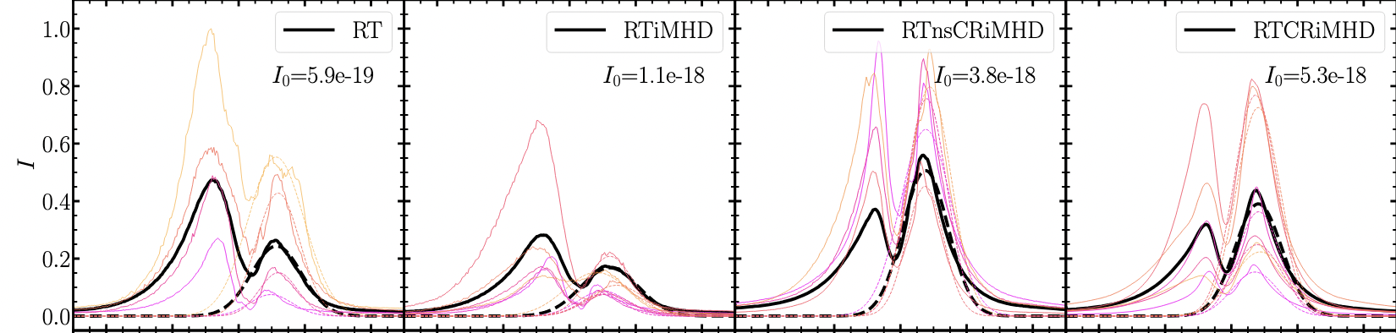
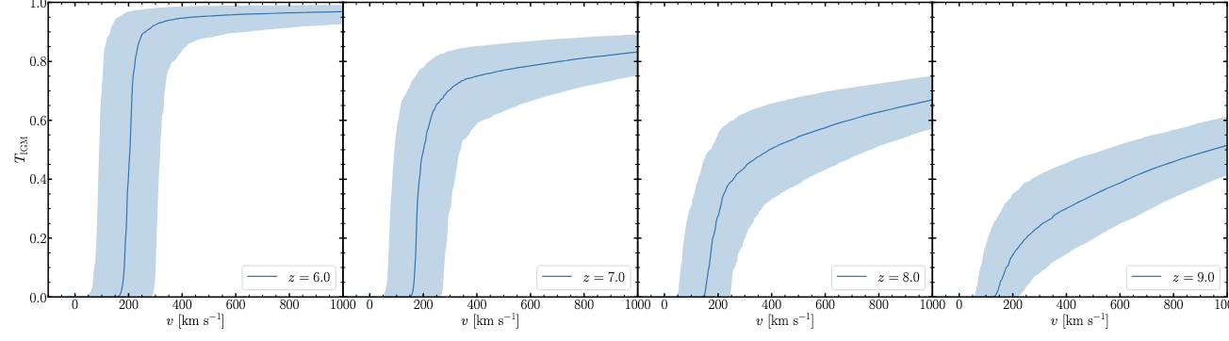
Visibility of high-z LAE
Red peak asymmetric
Convolve with IGM damping wing from the Sherwood-Relic
Three IGM transmission levels
Yuan+ in prep
Notes:
Finally in the third project, we push to four different simulation runs and systemically investigate the visibility of high-z LAE. The visibilities strongly depend on the properties of the red peak from the galaxy as the blue peak will be completely absorbed by the IGM. Here we show the synthetic Lya spectra from four simulation runs and we fit a single Gaussian to their red peaks. We see that the red peaks are asymmetric and their tails extend to higher velocities of about 600 km/s than the Gaussian.
We further convolve the Lya spectra with the IGM damping wing from the Sherwood-Relic simulation. Here we show the redshift evolution of the median damping wing and the associated 1-sigma uncertainties. We see the median damping wing completely absorbs the photon below about 200 km/s. We further define the lower bound, median, and upper bound as three IGM transmission levels.

Slide 11
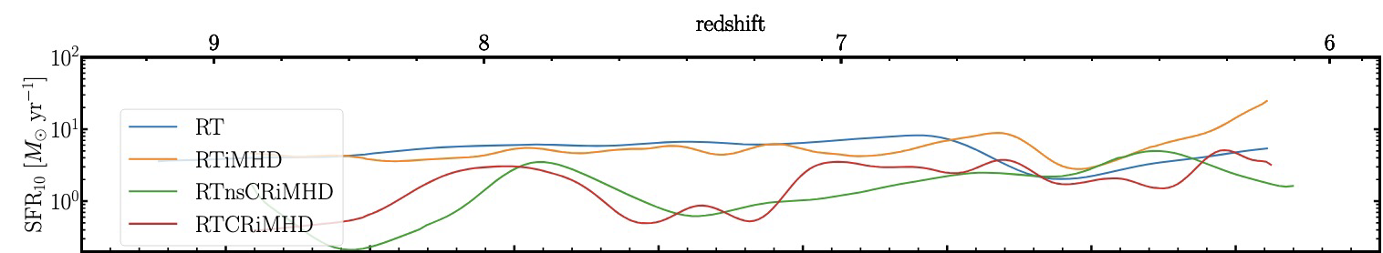
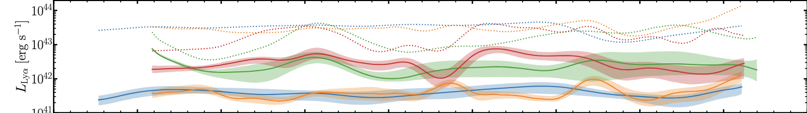
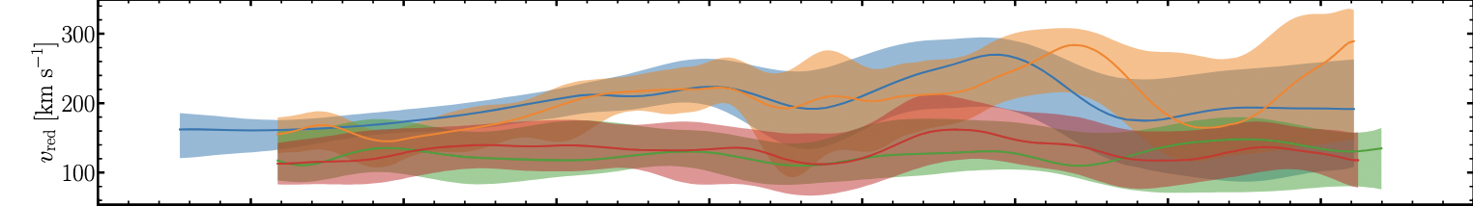
Time evolution of the (“intrinsic”) galactic Ly𝛼 properties
Yuan+ in prep
Two CR runs have more bursty SFH, higher ISM scattered $L_{Lyα}$, and lower $v_{red}$
Notes:
We next perform the merger sequence analysis for all four simulations. Here from top to bottom, we show the time evolution of SFR, Lya luminosity, and velocity of red peak. Overall, two CR runs have more bursty SFH compared with RT and RTiMHD. The time evolution of the intrinsic and scattered Lya luminosity closely follows that of SFH. However, we see that RT and RTiMHD have significantly lower scattered Lya luminosity. The vred evolutions of RT and RTiMHD are generally more episodic and go to high values of about 250 km/s, while those of two CR runs are relatively smooth and have a lower value of about 150 km/s. We also see vred varies strongly with LOS, as shown by the shaded region.

Slide 12
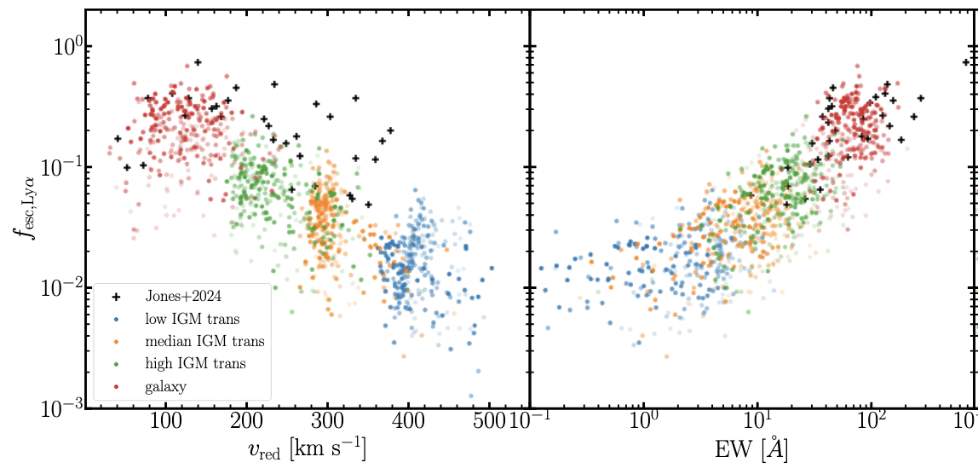

Decipher Ly𝛼 escape
Reproduce the correlation $f_{esc, Lyα}$ - $v_{red}$, as well as $f_{esc, Lyα}$ - EW
IGM transmission from patchy reionization is the main driver of these correlations
Yuan+ in prep
Notes:
We finally decipher the Lya escape. Here we compare fesclya to vred and EW for RTCRiMHD simulations. The blue to red dots show our simulation results for 3 IGM transmission levels and their galactic values. We reproduce the negative correlation between fesclya and vred, as well as the positive correlation between fesclya and EW. Interestingly, we see that IGM transmission from patchy reionization is the main driver of these correlations.

Slide 13
Papers:
arxiv: 2401.02572
arxiv: 2303.16225
Conclusions
Ly𝛼 probe feedback-regulated LyC escape:
Different simulated physics have a huge impact on Ly𝛼 and LyC observables.
Different simulation runs span universal relations in the Ly𝛼 - LyC parameter space, suggesting that LyC can be inferred from Ly𝛼.
Galaxy merger as an origin of LAE:
Galaxies with frequent mergers have very bursty star formation histories that drive episodes of high intrinsic Lyα emission and facilitate the escape of Lyα photons along channels cleared of neutral gas.
Visibility of high-z LAE:
The galaxy merger cycle strongly modulates the galactic Ly𝛼 signatures, which all also strongly vary with viewing angle.
Notes:
I will leave the conclusions here. Feel free to check those papers and the upcoming ones.

